Slide 1
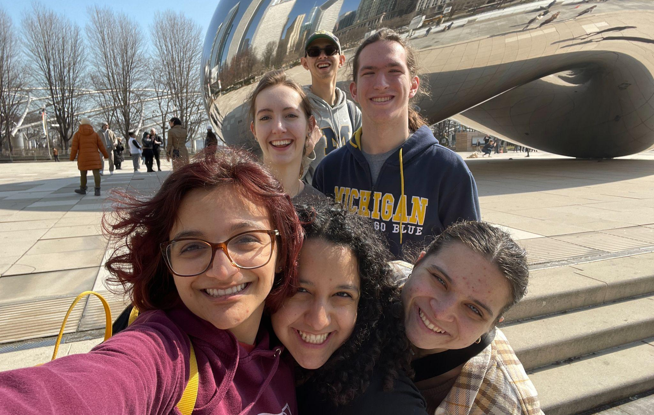
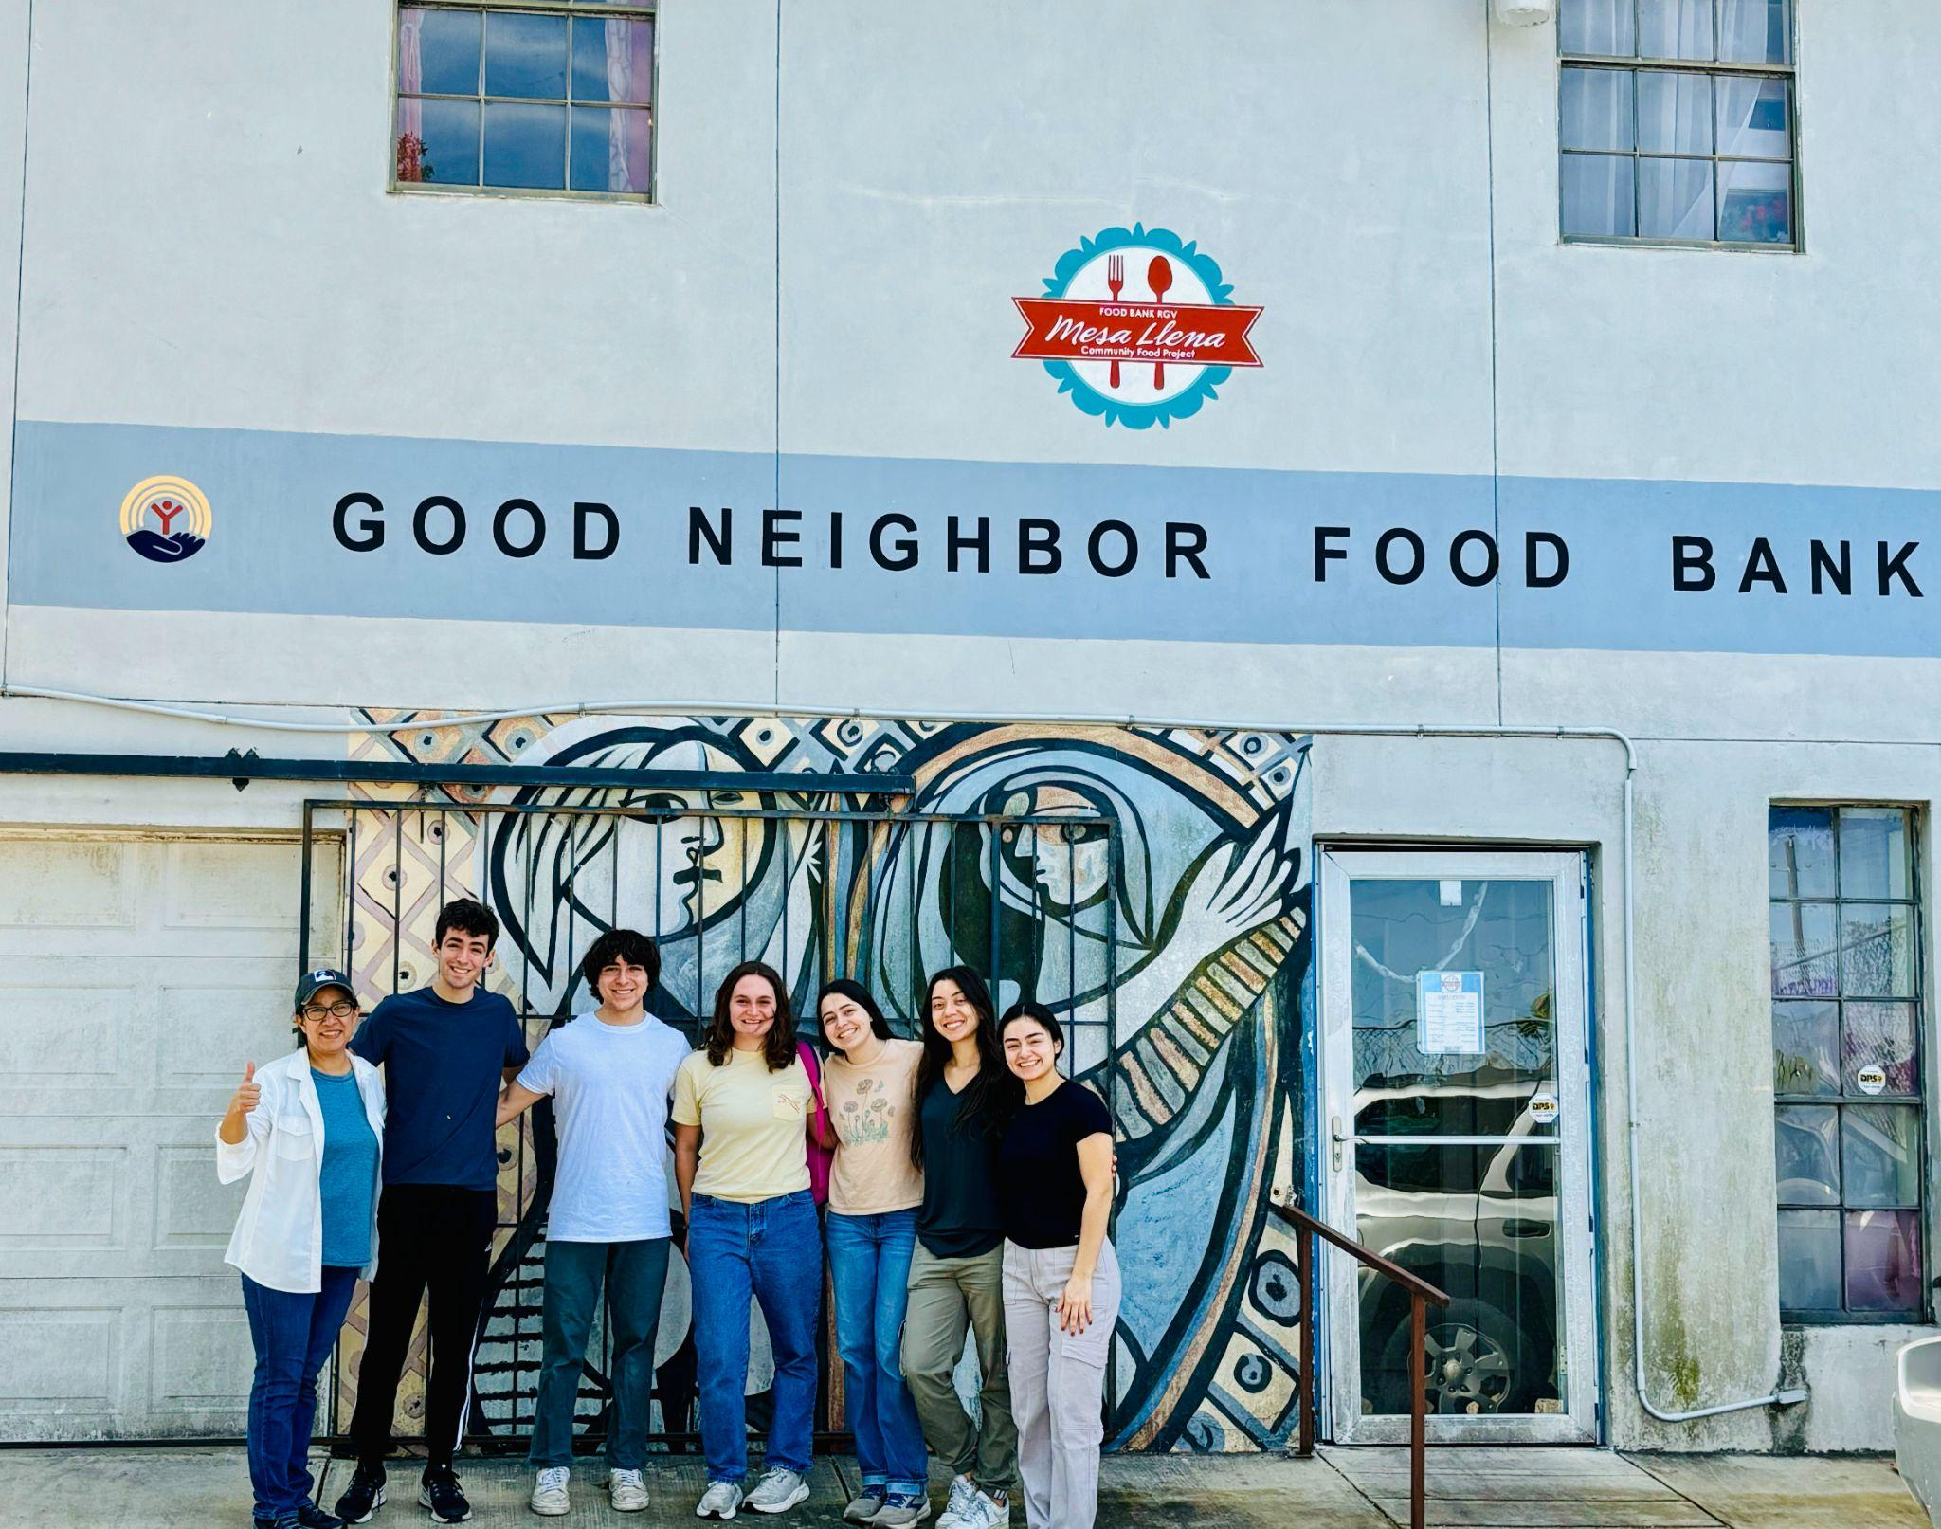
Alternative Spring Break!

Slide 2
Let’s Break the Ice!
What experiences have you had with service?
How has service deepened your faith and your relationship with God?
How do you feel called to serve now or in the future?

Slide 3
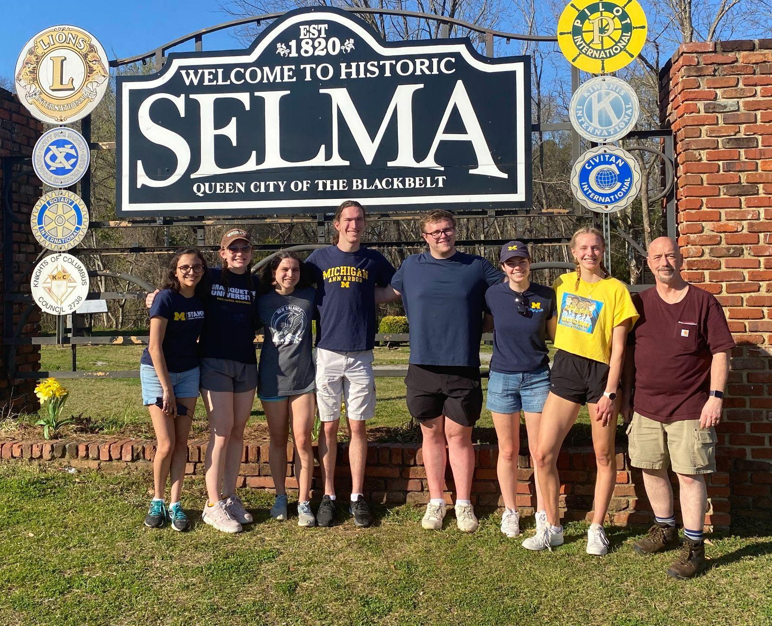
What is Alternative Spring Break (ASB)?
Service immersion (Feb 28- Mar 8)
Encounter those living on the margins
Deepen our understanding of the root causes of the social injustices that impact these communities
Service with grassroots initiatives which are making a difference in the community
Reflect on our experiences of service and encounter
Growing in relationship with SMSP community

Slide 4
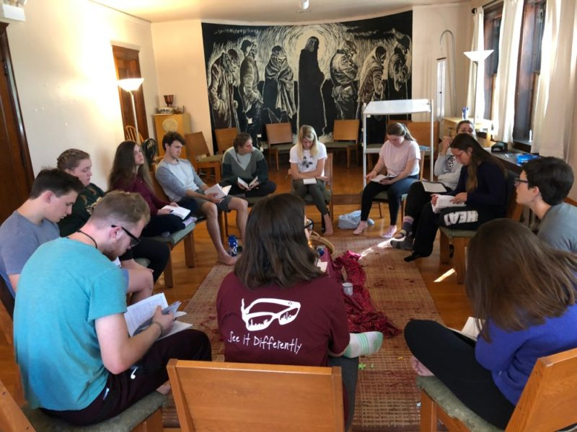
What is Alternative Spring Break (ASB)?
Participate in 5 weeks of formation
build community
deep dive into social and historical contexts of sites
Prepare ourselves for encounter
Our hope through community, solidarity, and mutual giving, you will experience the love of Christ active in the world and in the people you meet!

Slide 5
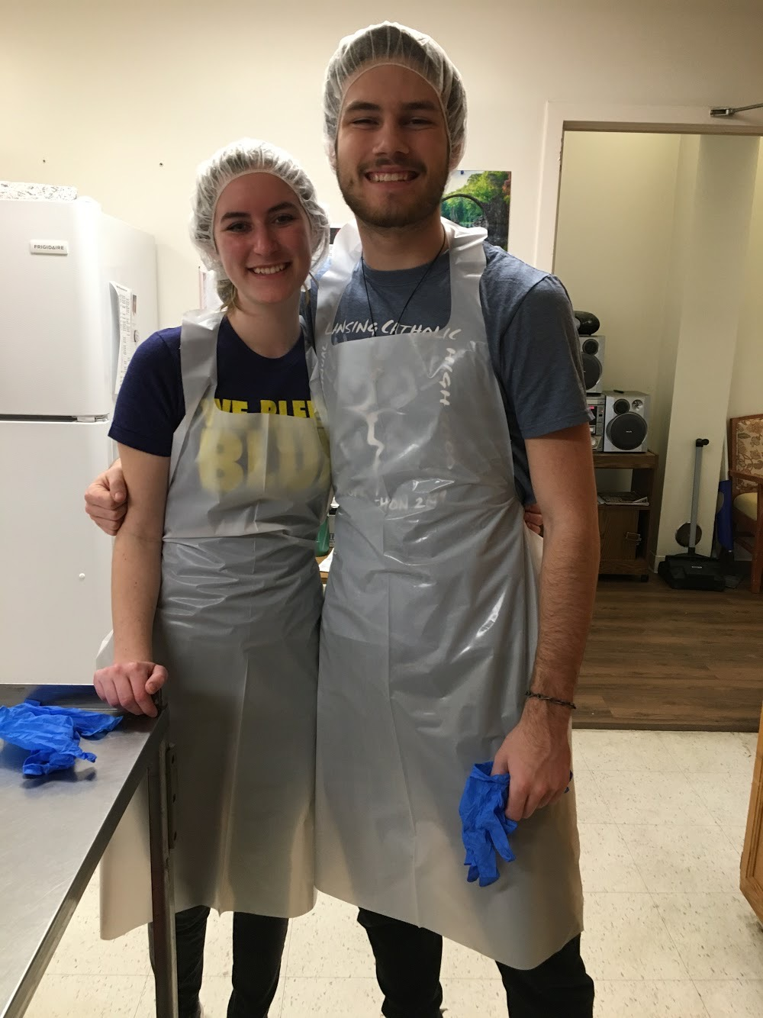
ASB Sample Trip Schedule
7:30 Morning Prayer
8:00 Breakfast
9:00 Partner Agency
1:00 Lunch with a panel of community
members
2:30 Cultural Experience
4:00 Reflection
5:30 Dinner Prep
6:00 Dinner
7:30 Free Time
8:30 Group reflection & community
time
9:30 Free time/rest

Slide 6
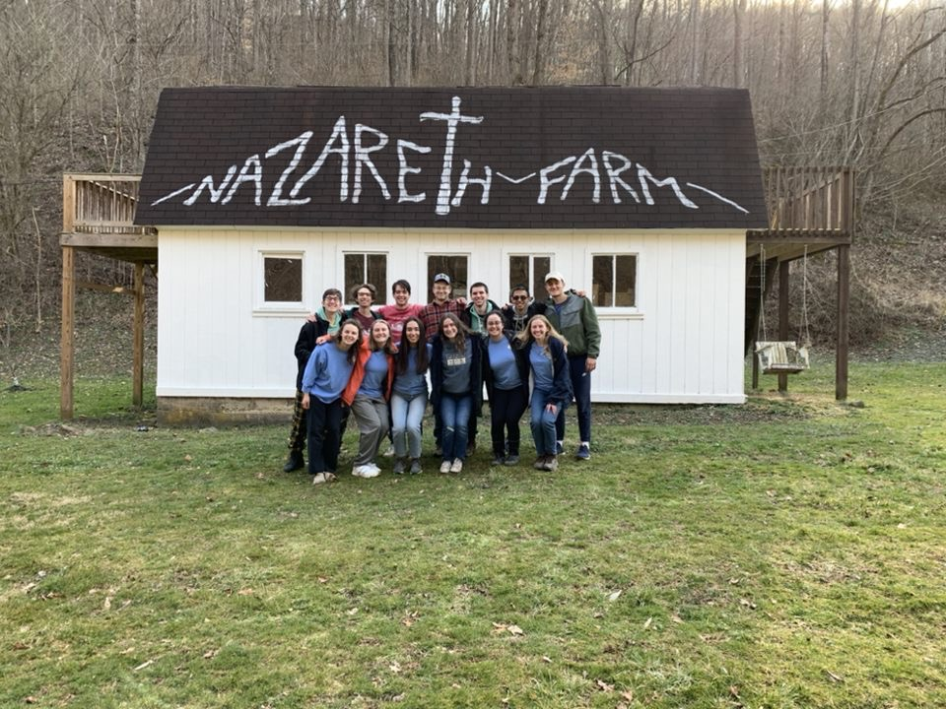
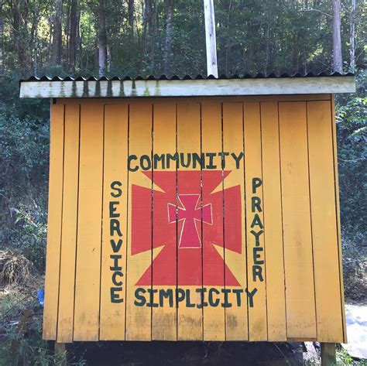
Nazareth Farm
West Virginia
Sustainability & Environmental Justice
Immersion

Slide 7
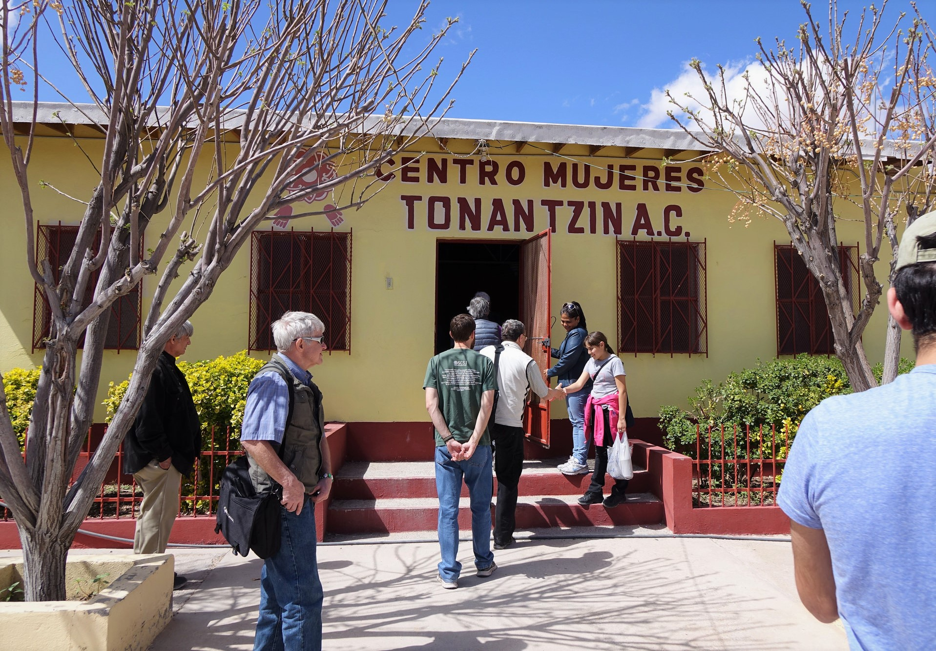
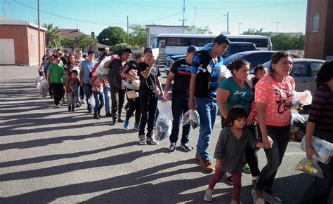
The Encuentro Project
El Paso, Texas
Immigration Immersion

Slide 8
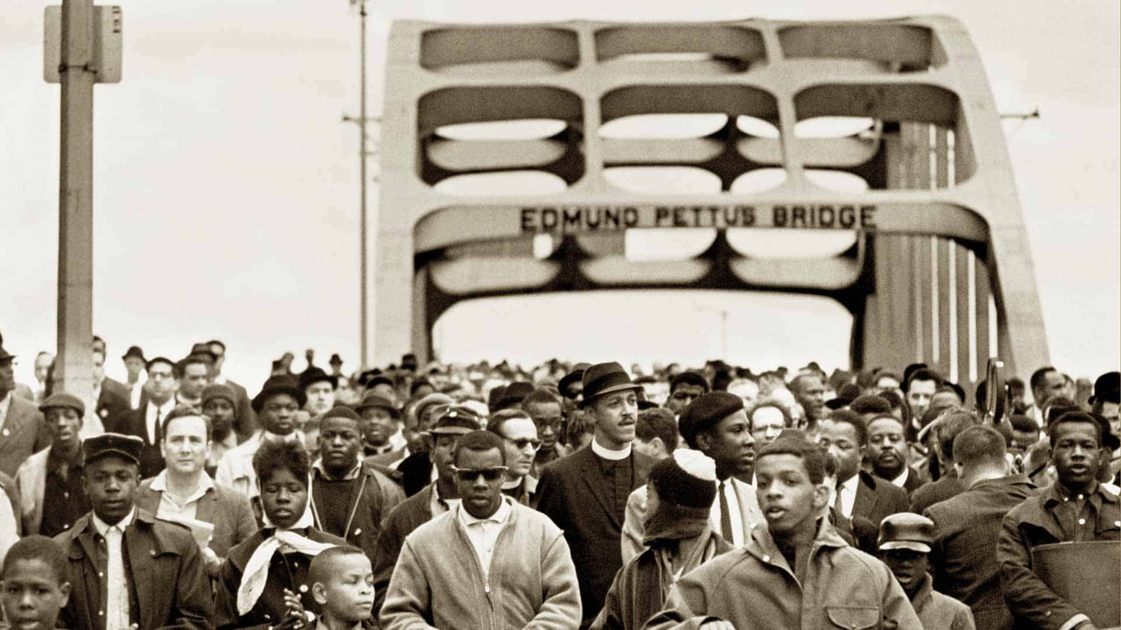
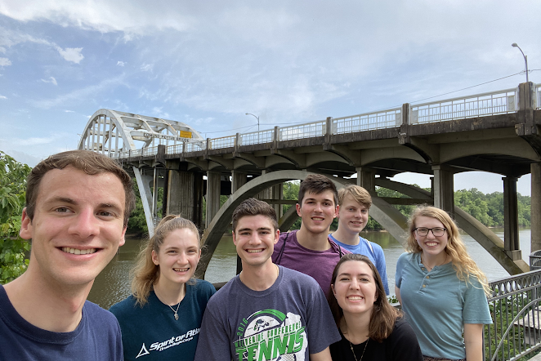
Selma, Alabama
Racial Justice Immersion

Slide 9
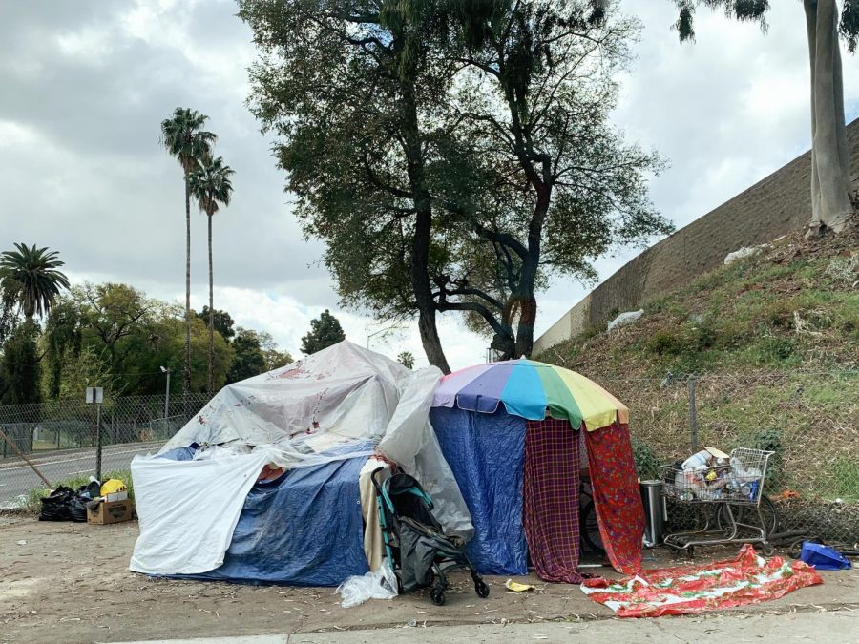
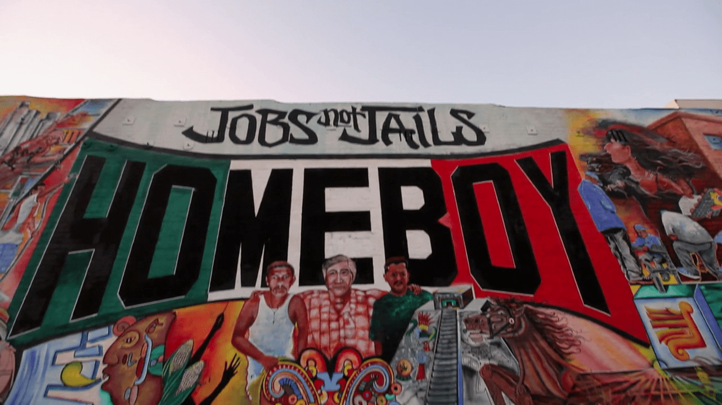
Dolores Mission
Los Angeles
Homelessness, reentry, economic opportunity, education, immigration

Slide 10
How much does ASB cost?
 | Naz Farm | Selma | El Paso | LA
Actual Price | $550 | $950 | $1600 | $1600
Subsidized Price | $400 | $700 | $1200 | $1200
Centennial Special | $200 | $350 | $600 | $600

Slide 11
Early Bird Special!
Apply and submit your $100 deposit by the 1st application deadline (December 23) and receive an additional $50 off the total cost of your trip!

Slide 12
Wait! There’s More?!
Refer a friend who attends ASB and get a $25 rebate, up to 2 friends.
All rebates are made payable March 9.

Slide 13
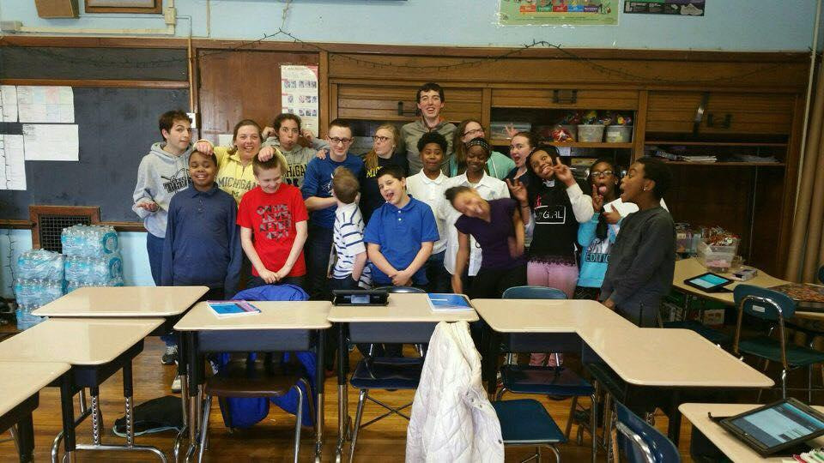
Fundraising
Individual Fundraising Efforts
Bucket Drive at SMSP in February

Slide 14
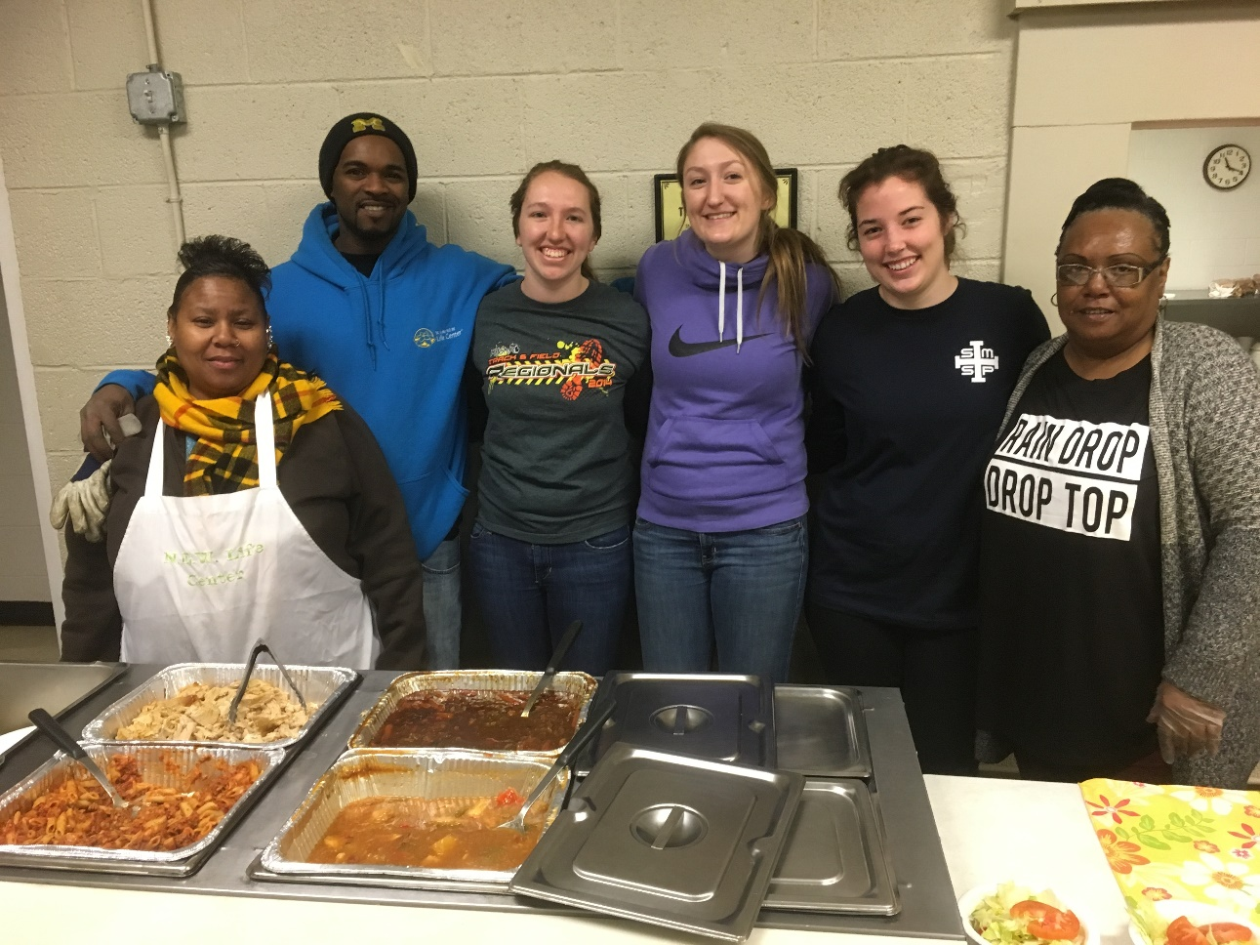
Factors Determining Placement
The date you apply
Class year
Previous ASB placements

Slide 15
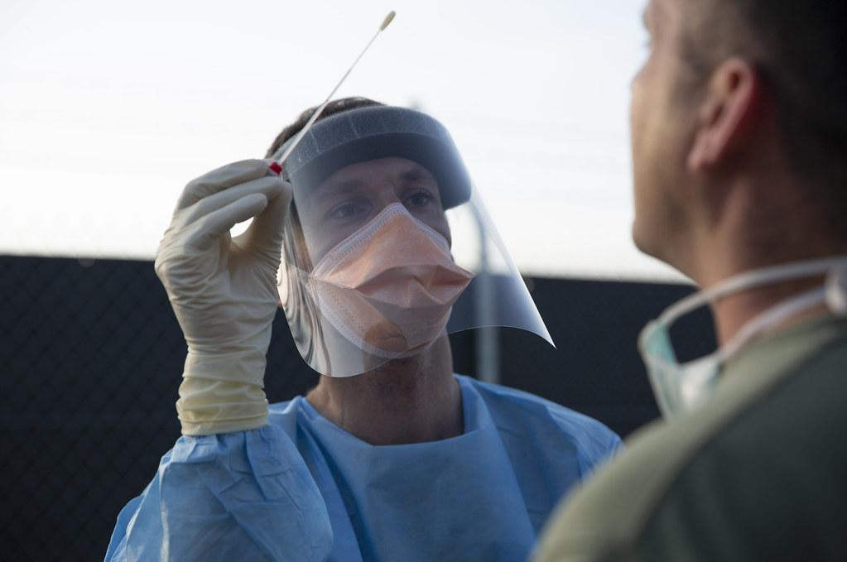
COVID Precautions &
Vaccination Requirements
Some sites require vaccination and testing
Vaccination status will be confirmed

Slide 16
HOW DO I APPLY?
Google Form now LIVE!
Priority Deadline: December 23 11:59pm
Final Deadline: January 13 11:59pm

Slide 17
Questions?
Contact Julia Novotny (jnovotny@smspnewman.org)

